Slide 1



Google Earth Engine Workshop - Canadian Symposium for Remote Sensing
June 21, 2021

Slide 2
Structure for the Course
Alternating lectures/demos with breakout rooms for you to work through exercises yourself
An “answer example” will be provided after each breakout session to provide ONE example of how the task can be completed with Earth Engine
Keep in mind that there are often many ways to achieve the same/similar results
All data and scripts are available in Google Drive
You have ‘viewing’ privileges to this drive
You can work from the ipynb scripts, but your results/changes won’t save
I recommend downloading the entire folder locally, unzipping it, and then re-uploading it to your own Google Drive.
To keep file paths the same within Google Drive, my folder is called “CSRS GEE workshop”
The time table and breakout room links are found in that Google Drive
Scripts:
These scripts were created by Koreen and Adam for this course. In many cases they were adapted from bits and pieces found in the Developer’s guide or on forums (citations are given where appropriate). If you use scripts directly from here to produce useful results, please acknowledge us!

Slide 3
To access Earth Engine...
First you need to be granted access:
Request it here: https://signup.earthengine.google.com/#!/
It is only available for research and education purposes so be clear that you are using it for class
Once granted access, we will use the CoLab Environment for learning.
https://colab.research.google.com/
If you are unfamiliar with basic scripting, or having significant difficulties running my example scripts, I suggest you first work through “Earth Engine Objects and Methods” and “Functional Programming Concepts”. There are also numerous tutorials for the Javascript API.

Slide 4
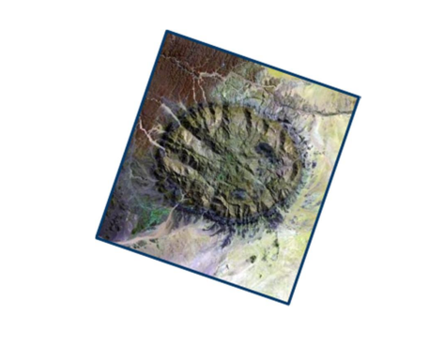
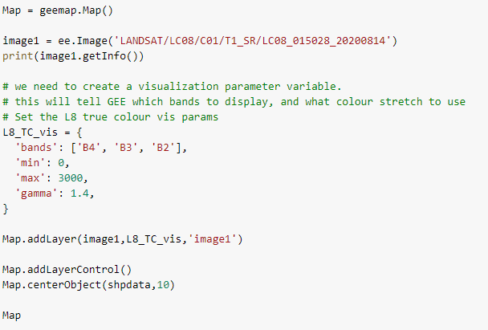
What can you do with Earth Engine?
Get a single image and visualize it:

Slide 5
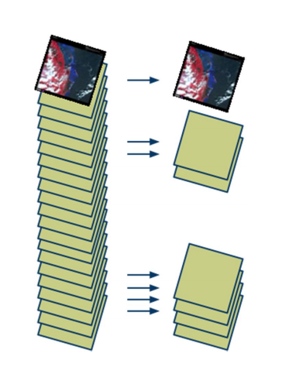
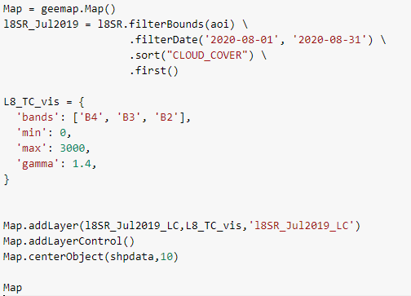
What can you do with Earth Engine?
Get any image that fits your criteria:
(i.e. filter an image collection)
Filter by date, area, cloud cover, any property in the metadata

Slide 6
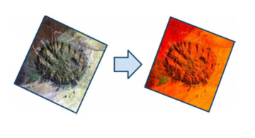
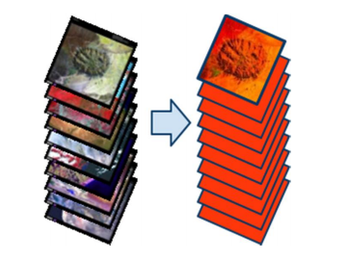
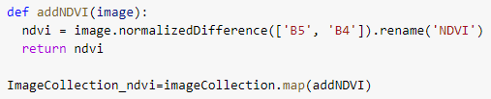
What can you do with Earth Engine?
Apply an Algorithm to an image
or image collection:

Slide 7
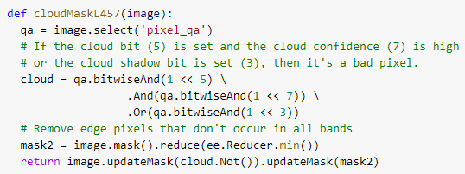
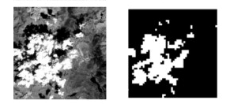
What can you do with Earth Engine?
Mask Pixels based on their value:
(e.g. pixel_qa band to mask out poor quality pixels)

Slide 8
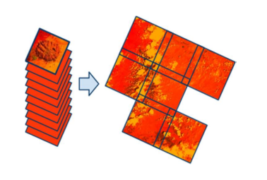
What can you do with Earth Engine?
Create composites and mosaics:
Compositing: process of combining spatially overlapping images into a single image based on an aggregation function
(mean, median, max, by “quality” or “best available” pixel)
Mosaicking: process of spatially assembling image datasets to produce a spatially continuous image

Slide 9
And many other things...
Perform spatial analysis
Extract data and time series information
Create timelapse animations
Perform change detection
Create charts and graphs
Create and execute your own functions and algorithms
Make applications to share results of your work
….and much more...

Slide 10
What can’t you do with GEE?
What shouldn’t you do with GEE?
From Gorelick et al, 2017: “It performs poorly for:
Operations which a local value can be influenced by arbitrarily distant inputs
operations that require a large amount of data to be in hand at the same time
operations that involve long-running iterative processes...”
Does not contain phase information of SAR (only GRD products)
Server-side For loops are evil.
Use it for commercial purposes without a commercial license.
Notes:
It performs poorly for operations in which a local value can be influenced by arbitrarily distant inputs, such as watershed analysis or classical clustering algorithms;
operations that require a large amount of data to be in hand at the same time, such as training many classical machine learning models;
and operations that involve long-running iterative processes,such as finite element analysis or agent-based models.

Slide 11
The many ways to run GEE
The many ways to connect data to GEE
Javascript code editor
Python
Local installation
Local installation through Jupyter Notebook
Google CoLab
Custom built applications
Google Drive
Google Cloud
Earth Engine Assets

Slide 12
In this course...
We will run GEE using python through Google Colab
Requires no setup
Packages are up to date and environments are the same between users
We will install the geemap package
Provides visualization and analysis functionality for GEE in Python
Provides documentation and demos of how to run GEE in Python
Has some limitations in Google CoLab.
Has an automatic javascript to python conversion function

Slide 13
Some Earth Engine specifics
A crash-course

Slide 14
Server-side vs client side
Any ee object is server side
Any ee function is server side
Basically anything you use is server-side unless you create it yourself, or translate it
Client vs. Server documentation
Note: the documentation suggests caution when using .getInfo(), but this is less important when using Google Colab

Slide 15
Printing and getInfo()
In the Javascript API, the most common method of “debugging” is to use print statements.
In Python, this is much less straightforward.
We use getinfo() to “get info” about our data, but it doesn’t print in an easily-readable way.
Extra formatting is often required.

Slide 16
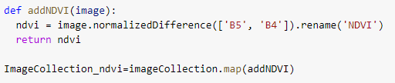
“Mapping” functions (i.e. .map())
In Earth Engine, we use the .map() function to “map” over an image collection.
This allows us to apply a function to every image in a collection without looping.
This should not be confused with geemap’s .Map() function for drawing results.

Slide 17
Custom Function
# this is a function
def functionName(variable):
output = x * variable
return output
# how to map a function over an image Collection
newImageCollection = imageCollection.map(functionName)

Slide 18
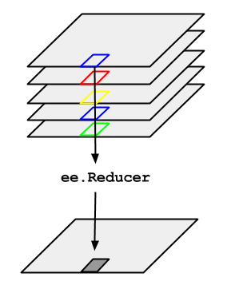
Reducers

Slide 19
Reducers
Reducers are the way to aggregate data over time, space, bands, etc. in Earth Engine.
ee.Reducer
Reducers can specify a simple statistic to use for the aggregation or a more complex summary of the input data
Minimum, maximum, mean, median, standard deviation, etc.
histogram, linear regression, list
Reductions may occur over time or space
Time: imageCollection.reduce()
Space: image.reduceRegion(), image.reduceNeighborhood(), bands image.reduce()

Slide 20
Image Collection Reductions
Pixel-wise reducers reduce the collection of images to an individual image
the output is computed pixel-wise
each pixel in the output is composed of the median/mean/min/max value of all the images in the collection at that location
Example: get all Landsat images within a growing season and compute the median pixel-wise value
# Load an image collection, filtered so it's not too much data.
collection = ee.ImageCollection('LANDSAT/LT05/C01/T1')
.filterDate('2008-01-01', '2008-12-31')
.filterBounds(point)
# Compute the median in each band, each pixel.
# Band names are B1_median, B2_median, etc.
median = ImageCollection.reduce(ee.Reducer.median())

Slide 21
Image reductions
Analogous to ImageCollection Reductions, except the bands of a single image are reduced, rather than band-wise reduction across images
# Load an image and select some bands of interest.
image = ee.Image('LANDSAT/LC08/C01/T1/LC08_044034_20140318')
.select(['B4', 'B3', 'B2']);
# Reduce the image to get a one-band maximum value image.
maxValue = image.reduce(ee.Reducer.max())

Slide 22
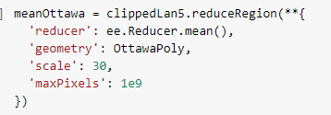
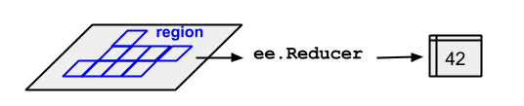
Statistics of an image within a single region
Use a reduceRegion to calculate the mean/min/max/stdev of all pixels within a SINGLE feature in a feature collection

Slide 23
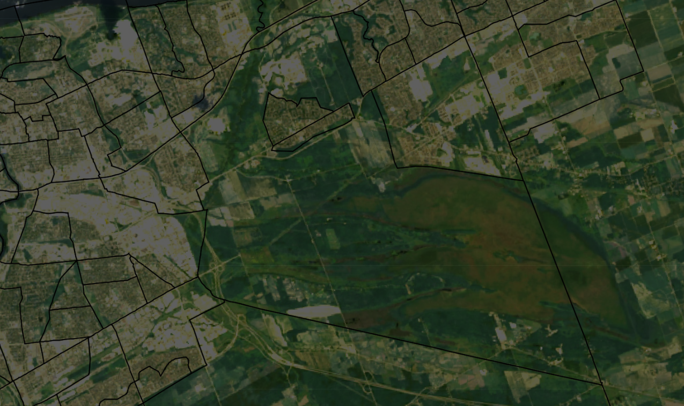
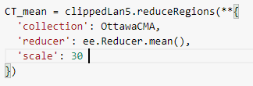
Statistics of an image within a several regions
Use a reduceRegions to calculate the mean/min/max/stdev of all pixels within each feature in a feature collection

Slide 24
Javascript to Python Conversion
To be presented in PM

Slide 25
JavaScript to Python Conversion
General rules:
Remove “var” (variable definition in Javascript)
Remove ;
Convert // comments to #
For multi-line commands, add a \
For functions:
Python functions are “defined”. See function structure above.

Slide 26
Javascript to Python Conversion - Example 1
Javascript:
// Load a Landsat 8 collection for a single path-row.
var collection = ee.ImageCollection('LANDSAT/LC08/C01/T1_TOA')
.filter(ee.Filter.eq('WRS_PATH', 44))
.filter(ee.Filter.eq('WRS_ROW', 34))
.filterDate('2014-01-01', '2015-01-01');
// Compute a median image and display.
var median = collection.median();
Python
# Load a Landsat 8 collection for a single path-row.
collection = ee.ImageCollection('LANDSAT/LC08/C01/T1_TOA') \
.filter(ee.Filter.eq('WRS_PATH', 44)) \
.filter(ee.Filter.eq('WRS_ROW', 34))
# Compute a median image and display.
median = collection.median()

Slide 27
Javascript to Python Conversion - Example 2
Javascript
// Load a Landsat 8 collection for a single path-row.
var collection = ee.ImageCollection('LANDSAT/LC08/C01/T1_TOA')
.filter(ee.Filter.eq('WRS_PATH', 44))
.filter(ee.Filter.eq('WRS_ROW', 34));
// This function adds a band representing the image timestamp.
var addTime = function(image) {
return image.addBands(image.metadata('system:time_start'));
};
// Map the function over the collection and display the result.
print(collection.map(addTime));
Python
# Load a Landsat 8 collection for a single path-row.
collection = ee.ImageCollection('LANDSAT/LC08/C01/T1_TOA') \
.filter(ee.Filter.eq('WRS_PATH', 44)) \
.filter(ee.Filter.eq('WRS_ROW', 34))
# This function adds a band representing the image timestamp.
def addTime(image):
return image.addBands(image.metadata('system:time_start'))
# Map the function over the collection and display the result.
print(collection.map(addTime))

